Slide 1
SWEWars

Slide 2



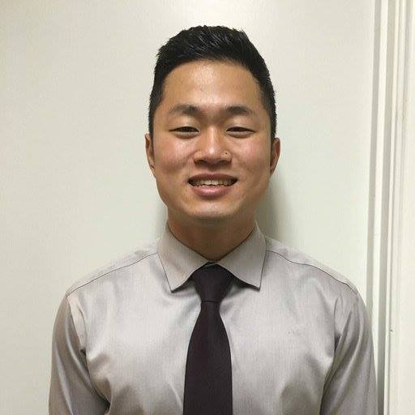

Group members
Diana Ruth
Clint Ascencio
Tony Serino
Jon Lim
Jamie Barbosa
Non-graduating Senior
EE/CS Double Major
Hometown: Alpharetta, GA
Fun Fact: has a half-corgi
named Ritz
Responsibilities:
UI
Angular/JS
External Database Scraping
Senior
Hometown: Austin, TX
Fun Fact: is a vampire
Responsibilities:
Docker/Carina
Created Models
Populated Database
Implemented API
Senior
Hometown: Austin, TX
Fun Fact: Once killed a man
Responsibilities:
Docker/Carina
Created Models
Populated Database
Implemented API
Senior
Hometown: Seoul, South Korea
Fun Fact: Once saved a puppy from a burning building
Responsibilities:
Unit Tests
Set up Database
Search Functionality
Set up Docker
Technical Writer
Senior
Hometown: Schertz, TX
Fun Fact: Was a Broadway actress in a past life
Responsibilities:
Tech. report
Front End with AngularJS
Exercised other group’s API
Search Functionality

Slide 3
About
Shows Star Wars information and relationships
People
Planets
Species
Intended users: Star Wars lovers & nerds

Slide 4
Data Collection
SWAPI
Scraped basic data about each person, planet, & species
Also gave us misc. info: climate, hair color, height, gravity, etc.
Wookieepedia
Intended to use their API, but we didn’t realize it was outdated and difficult to use
Manually scraped images and descriptions for each model and added to programmatically collected data

Slide 5
api
Lists
/get_people
/get_planets
/get_species
Individual
/get_person/{ID}
/get_planet/{ID}
/get_s/{ID}
Related Information
/person/{ID}/planet
/person/{ID}/species
/planet/{ID}/people
/planet/{ID}/species
/species/{ID}/people
/species/{ID}/planet
/search/{query}

Slide 6
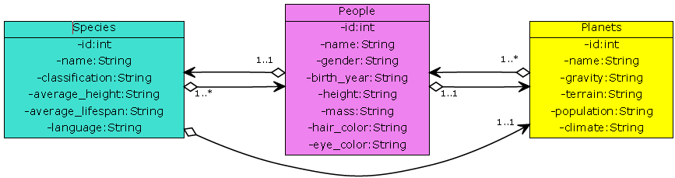
uML Relations

Slide 7
Demonstration
http://www.swewars.me/

Slide 8
Tools
Front End
Twitter Bootstrap
AngularJS
Back End
Python
Flask
Whoosh
Docker
Hosting
Carina
Namecheap
Collaboration
GitHub
Slack
Continuous Integration
Travis CI
API
Apiary
www.swapi.co
Wookieepedia

Slide 9
Team Statistics
Commits: 263
Issues: 50
Unit Tests: 52

Slide 10
individual Statistics

Slide 11
Return of the Api Critique
What did we do well?
UI
Clean API calls
Database design
What did we learn?
How to use AngularJS
How to use SQLAlchemy
What can we do better?
Not have all attributes as strings
Not include descriptions in search
Go back to same page when clicking on a model
What puzzles us?
Docker
Search incompatibilities

Slide 12
ComProdb Critique
What did they do well?
Clean design
Easy to navigate
What did we learn from their website?
Competitive programming is intense
Has (gained/lost) interest in recent years
What can they do better?
Specific problems and contests could have more detail
Apiary wasn’t updated
More interesting UI
What puzzles us about their website?
Why does table loading stall sometimes?

Slide 13

questions?

